Slide 1
Azure Storage
Microsoft Research

Slide 2
Azure Storage
Blobs
Storage for any type of data, analogous to files in a file system, with individual blobs storing up to 1 TB of data
Queues
Reliable messaging for workflow processing and for communication between applications or application components
Tables
NoSQL storage of semi-structured data for rapid development and fast access to large quantities of data
Files
Shared storage for VMs and cloud services using Server Message Block (SMB) protocol

Slide 3
Blob Storage
Accounts
Containers
Blobs
images
schema.jpg
a4rlabs
Png/flow.png
documents
Labs.pdf
3 to 24 characters
0-9 and a-z
Unique within Azure
3 to 63 characters
0-9, a-z, and dashes
1 to 1,024 characters
Any characters (including slashes)
URL characters must be escaped
Max. 254 path segments

Slide 4
Blob URLs
Accounts
Containers
Blobs
images
schema.jpg
a4rlabs
Png/flow.png
documents
Labs.pdf
https://a4rlabs.blob.core.windows.net/images/schema.jpg

Slide 5
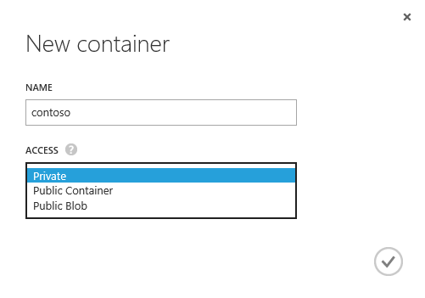
Access Policies
Each container is assigned one of three access policies
Private – Blobs can't be read anonymously or enumerated
Public Container – Blobs can be read anonymously, but cannot be enumerated
Public Blob – Blobs can be read anonymously and enumerated

Slide 6
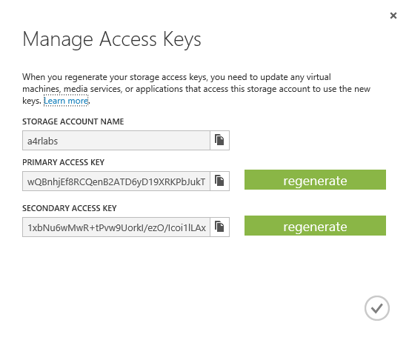
Access Keys
Access to storage by non-account-owners relies on keys for authentication
Two 512-bit keys per account
Keys should be "rolled" periodically for security
Keys can be used to generate shared-access signature (SAS) tokens for secure, time-limited access

Slide 7
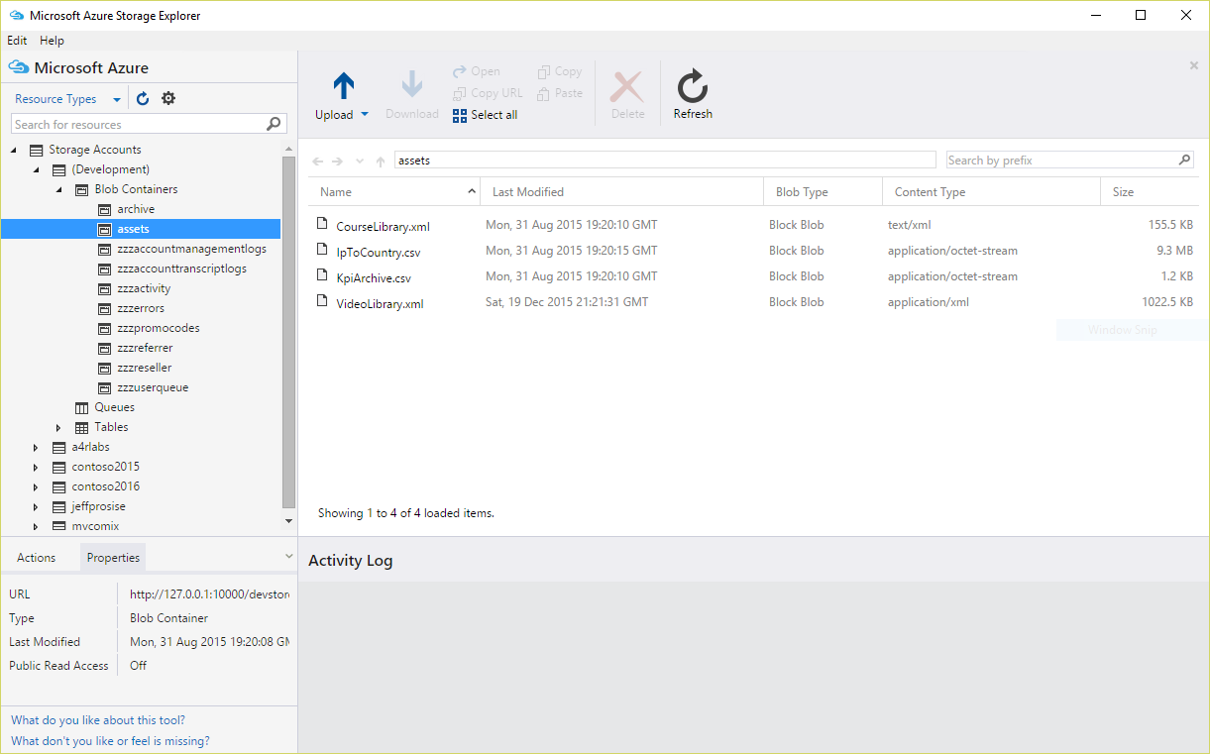
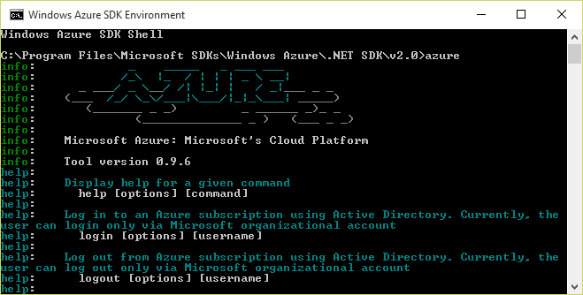
Azure Storage Tools
Portal doesn't provide functionality for uploading blobs
User free third-party tools to upload blobs instead
Microsoft Azure Storage Explorer (Windows, OS X)
Azure Command-Line Interface
(Windows, Linux, OS X)

Slide 8
Hands-On Lab
Azure Storage
StorageHOL (Azure CLI).html for Linux users
StorageHOL (Storage Explorer).html for Windows and OS X users

